Slide 1
Real time Audio Visualization Using Wi-fi
By:
David Cain

Slide 2
What is Audio Visualization?
-Animated imagery based on a piece of music
-This implementation will be volume intensity based, i.e. changes with the loudness of the music

Slide 3
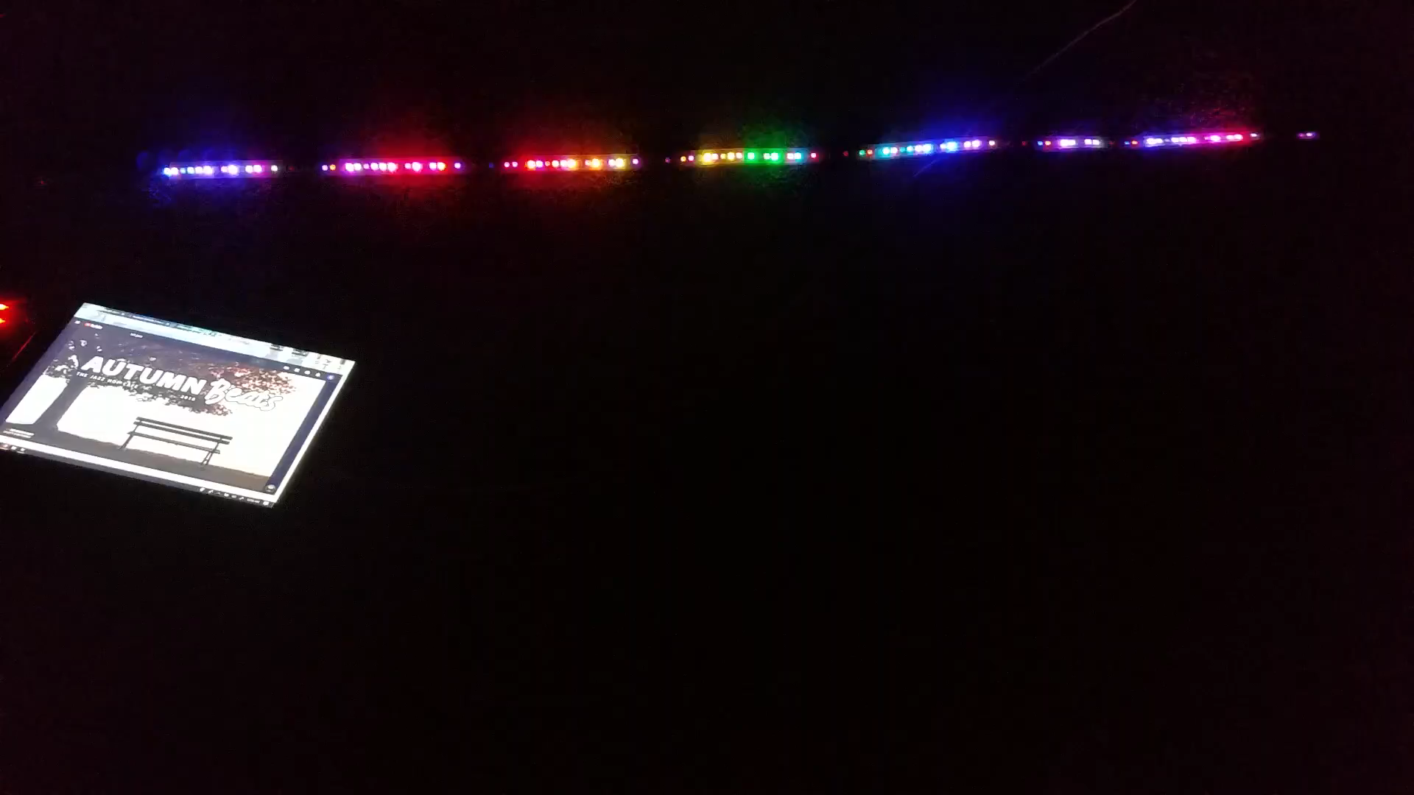
A prototype example
Similar concept but this implemented more audio processing
Everything was hardwired together which made it less desirable in cases where you want the mic in a separate location from the lights.

Slide 4
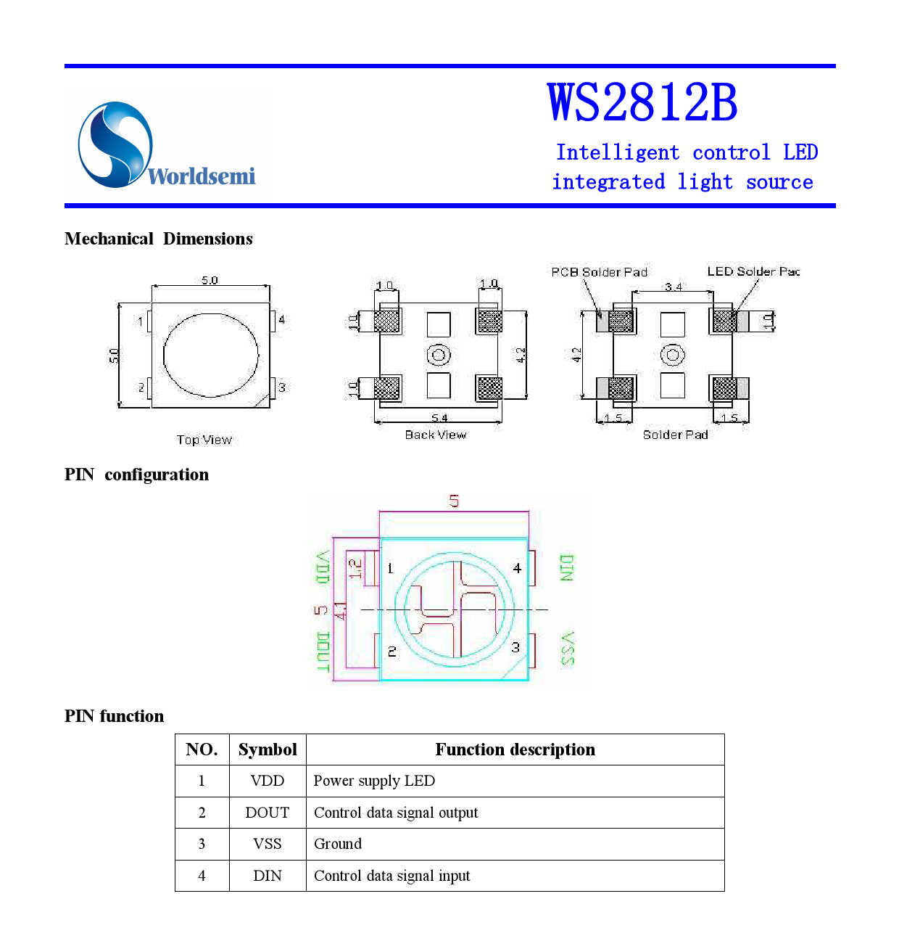
WS2812b LEDs
Individually Addressable RGB LEDs
This allows for designs and any color defined in the Hex RGB Spectrum
These LEDs are widely supported and have several libraries setup to be used with Arduino easily
FastLED
ALA

Slide 5
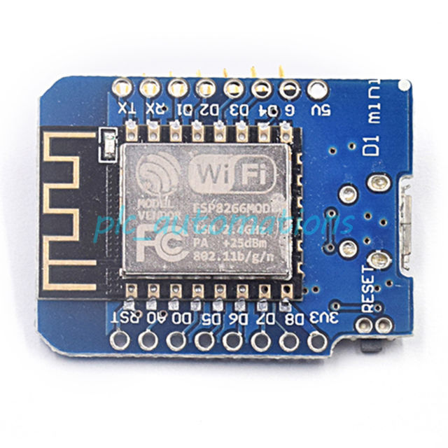
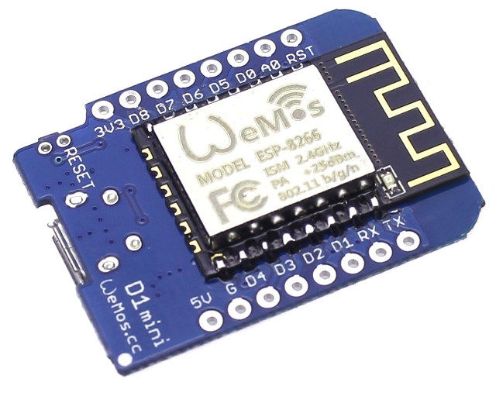
Arduino compatible microcontroller
Has built in Wi-Fi capabilities
80/160 MHz Clock Speed
4M bytes flash storage
Wemos ESP82666

Slide 6
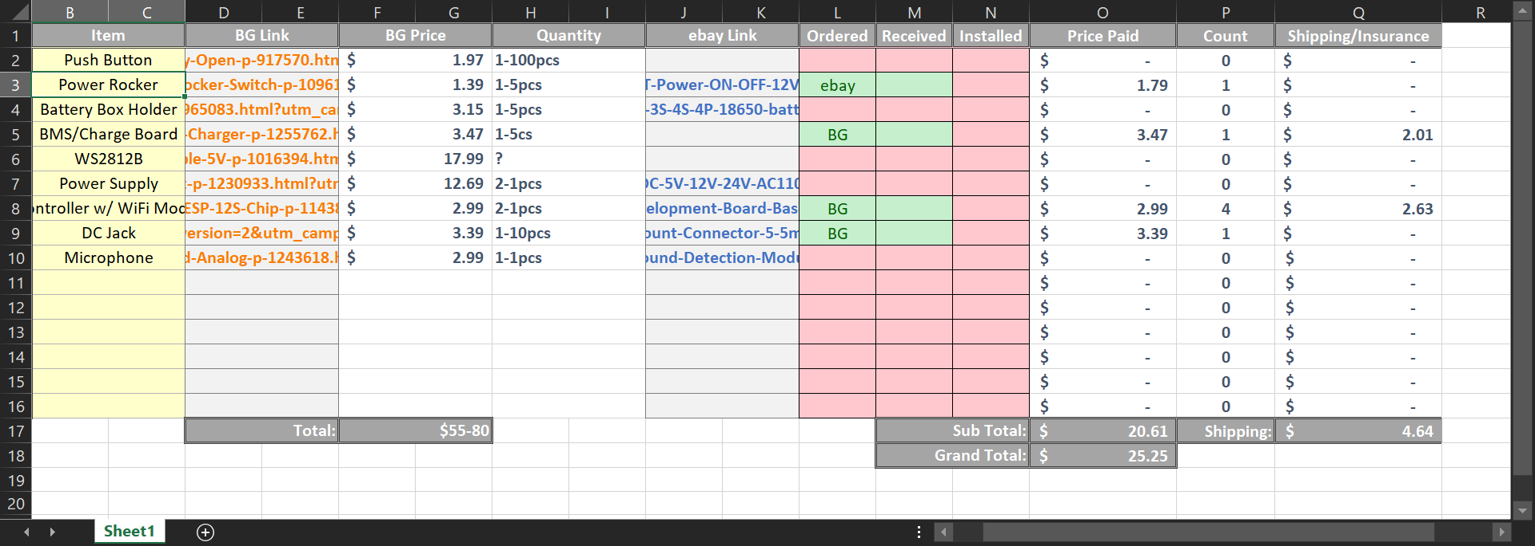
Rough Draft Expense Report

